Slide 1
Topic Four: Preparation of Financial Statement
Ibrahim Yusuf
MUST

Slide 2
Trial balance
Note: A trial balance is not a financial statement. It does not reflect the financial position of a company.

Slide 3
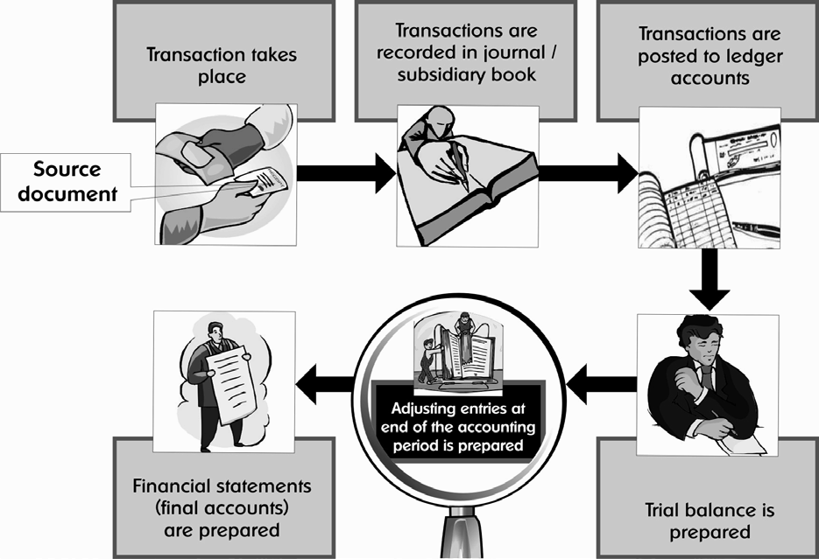
Diagram 1: The accounting cycle

Slide 4
Trial Balance- Introduction
‘Every debit entry has a corresponding credit entry.’ - is the main principle of the double-entry system of accounting. Hence if there are no errors, then the total debit balances and total credit balances of all the ledger accounts of a company should be equal.
Before preparing its financial statements, a company should check the arithmetical accuracy of its accounting records. A list of all the ledger accounts and their respective balances as at a specified point is called a trial balance.
A trial balance ensures the arithmetical accuracy of the accounting records. If the trial balance does not balance (i.e. debit totals are not equal to credit totals) then it means that there is definitely an error in the accounts. These errors need to be determined and rectified before the company can prepare its financial statements.

Slide 5
TRIAL BALANCE
DEFINITION
IT IS A STATEMENT SHOWING CREDIT AND DEBIT BALANCES FROM THE LEDGER.
A TRIAL BALANCE IS THE SUMMARY OF ALL THE LEDGER ACCOUNT BALANCES AT A PARTICULAR POINT IN TIME.
THE TRIAL BALANCE IS SIMPLY A LIST OF ALL THE LEDGER ACCOUNTS AND THEIR RESPECTIVE BALANCES AS AT A SPECIFIED POINT OF TIME E.G. AS AT 31 DECEMBER 20X3.
HELPS ARITHMETICAL ACCURACY AND FACILITATES FINAL ACCOUNTS.
Preparation of financial statements is the main object of the entire accounting exercise. The importance of the trial balance stems from the fact that financial statements cannot be prepared without a trial balance

Slide 6
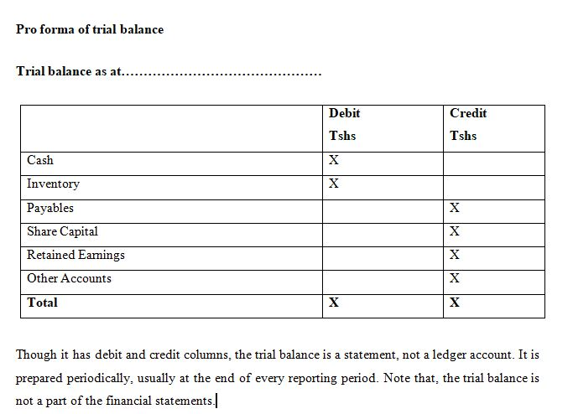
Trial Balance- Proforma

Slide 7
Purpose of a trial balance
After preparing all required ledgers, a trial balance is prepared, to list out at one place, the balances of all the ledger accounts. This helps the accountant to check the arithmetic accuracy of accounting. When preparing a trial balance, the debit and credit balances for each ledger account are totaled. If the totals of the debit column and the credit column of the trial balance do not balance, we know at once that there is some error in the ledger balance.
The fact that the trial balance agrees is a preliminary assurance that there are no mathematical / arithmetic errors in the preparation of the accounts ( to Help in locating errors).
Checking for mathematical / arithmetical accuracy is the primary purpose of the trial balance. However, because a trial balance presents the ledger account balances in a readily available format it is often used to prepare the financial statements

Slide 8
Relationship of the trial balance with the accounting cycle
The entire accounting exercise is summarized below:
(a) Transactions are identified and recorded in day books (journal, sales book, purchase book, cash book, etc.).
(b) Transactions are recorded from day books to ledger accounts.
(c) A trial balance is prepared from the ledger accounts. It is a list of the balances of all ledger accounts where total debits = total credits.
(d) A trial balance contains: ledger balances that affect the statement of profit or loss: balance of expense accounts and income accounts ledger balances that affect the statement of financial position: balance of asset accounts and liability accounts
(e) Balances that affect the statement of profit or loss are recorded in it and profit earned or loss incurred during the period is determined.
(f) Balances that affect the statement of financial position along with the profit or loss determined by them statement of profit or loss are recorded in it.
(g) The asset and liability side of the statement of financial position is totalled. The total of the assets side should be equal to the total of the liabilities side.

Slide 9
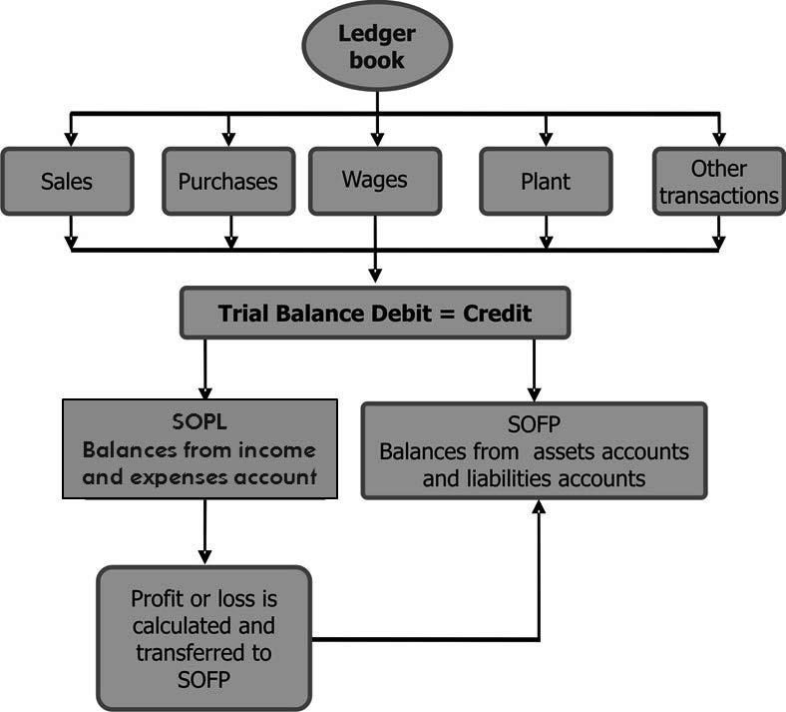
Diagram 2: Relationship of trial balance and financial statements

Slide 10
Steps involved in the preparation of a trial balance
Balance all the ledger accounts in the general ledger.
Calculate the totals of the balances in the accounts payable and accounts receivable ledger accounts. (A single consolidated figure will be taken for total receivables/payables in the trial balance - not all individual ledger accounts).
Prepare a trial balance.
Write the names of all accounts one after the other.
All credit balances are written in the credit column of the trial balance - against the name of the respective accounts.
All debit balances are written in the debit column of the trial balance - against the name of the respective accounts.
Total both the columns.
The two totals should be equal

Slide 11
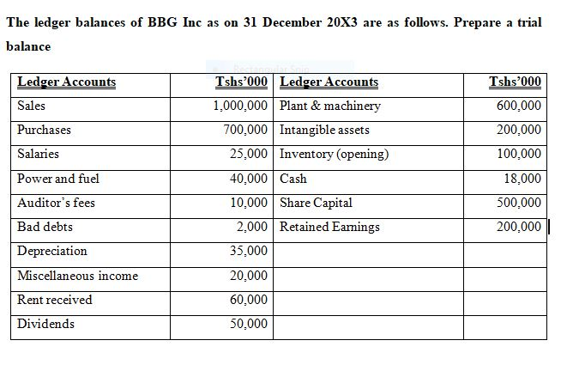
Example 1

Slide 12
Example
20x9
May 1 Bought goods on credit £220 from P Chausiku.
‘’ 2 Bought goods on credit £410 from A Lyon & Son.
‘’ 5 Sold goods on credit to P Mwanahawa for £60.
‘’ 6 Sold goods on credit to Z Kariwa for £45.
‘’10 Returned goods £15 to P Chausiku.
‘’ 11 Goods sold for cash £210.
‘’12 Goods bought for cash £150.
‘’ 19 Z Kariwa returned £16 goods to us.
‘’ 21 Goods sold for cash £175.
‘’22 Paid cash to P Chausiku £205.
‘’30 P Mwanahawa paid the amount owing by him £60 in cash.
‘’ 31 Bought goods on credit £214 from A Lyon & Son.
Enter all these transactions in T-accounts and prepare Trial Balance

Slide 13
Prepare a trial balance
There are two types of accounts:
Accounts that are transferred to the statement of profit or loss and closed at the year end. These are the incomes and expenses accounts.
Accounts that are taken to the statement of financial position and carried over to the next accounting year. These are the assets and liabilities accounts.

Slide 14
Limitations of a trial balance
The fact that the trial balance balances is a preliminary assurance that the accounts are free from any mathematical / arithmetic errors. However it is not conclusive proof of the absence of errors. It only shows arithmetical accuracy i.e. every debit has been provided a corresponding credit. Therefore, even if the totals of the debit column and the credit column agree, certain errors may remain unnoticed. Such errors are:
Errors of omission: these are errors caused by failure to record a transaction
Errors of commission: these are errors caused due to incorrect recording of a transaction in the day book, from day books to ledger, inaccurate totalling/ balancing etc.
Errors of principle: these include the types of errors which result from the violation of fundamental principles of accountancy e.g. capital expenditure treated as revenue expenditure and vice-versa.
Compensating errors: when two or more errors are committed in such a way that the net effect of these errors on the debit and credit of accounts is nil

Slide 15
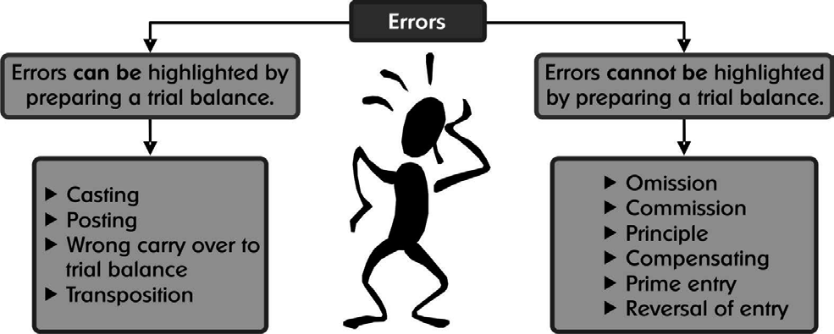
Types of errors

Slide 16
BASIC FINANCIAL STATEMENTS
The process of accounting ends with the preparation of the financial statements
The financial statements of an entity consist of a number of reports / statements - one such statement is the statement of financial position.
The statement of financial position is a statement which reflects the financial position of an entity as at a particular date. The statement of financial position (along with its companions)
The statement of profit or loss and the statement of changes in equity, function like a thermometer - they depict whether the company is ailing or flourishing
The three primary statements are not sufficient to report the financial performance and position of an entity. Financial statements have to contain some essential further information if they are to be helpful to investors and other users in taking decisions. For example, notes to accounts contain additional information about noncurrent assets, contingent assets and contingent liabilities

Slide 17
Financial Statement- Definition
Financial statements are the accounting reports which are compiled in conformity with the provisions of GAAP (Generally Accepted Accounting Principles) to meet the common needs of wide range of users. They provide information about the financial strength, performance and changes in financial position of an enterprise.

Slide 18
Objectives of financial statements
Financial reporting is aimed at responding mainly to the needs of external users of financial statements such as shareholders, banks, payables etc. in assisting them to assess:
The financial position of the entity as at a certain moment, (what the company owns and owes)
Its financial performance during a period (how much profit the company has made) and
The changes in the financial position from one period to the next. (how the company has performed this year compared to the last year)

Slide 19
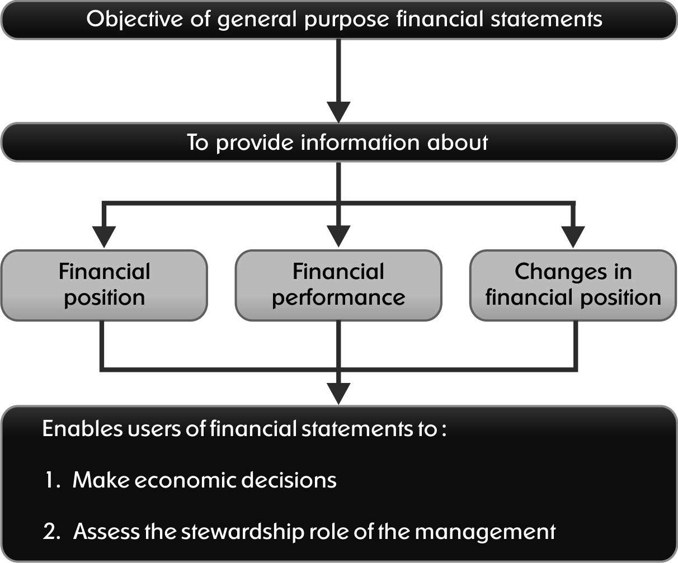
Diagram 3: Objectives of financial statements
Notes:
Financial statements only deal with past events and generally do not contain non-financial data. Financial statements are important as they enable shareholders, banks, trade payables, etc. who are the
external users of financial statements to assess the financial status of the company

Slide 20
Components of Financial Statements
Financial statements have the following components as per IAS 1 and IAS 7. :
1.Statement of profit and loss and other comprehensive income
2. Statement of financial position
3. Statement of changes in equity
4. Statement of cash flows
5. Notes to the financial statements
Notes:
In Tanzania, business entities are required to prepare the financial statements in accordance with the
Companies Act 2002. We will discuss all these financial components and the preparation of financial statements
of companies in accordance with prescribed formats and relevant accounting standards. The formats of financial
statements are provided in IAS 1 “Preparation and presentation of financial accounts”.
In most jurisdictions the structure and content of financial statements are determined by the local law. However
companies adopting IFRS have to prepare financial statements in accordance with the requirements of IAS1.
IAS 1 gives the following guidance and format for preparation of financial statements.

Slide 21
Statement of profit or loss and other comprehensive income (income statement)
This is a statement for a period, typically one year. Revenue, expenses and profits for the period for which it is prepared are to be included in the statement of profit or loss and other comprehensive income (also referred to as an income statement). It is like a video recording of all the transactions that occur in the period!
Reports operating success or failure for a period.
Summarizes revenues and expenses for period: month, quarter, or year.
If revenue > expense = Net Income.
If expenses > revenue = Net loss

Slide 22
Purpose of the Statement of profit or loss and other comprehensive income
To show whether an entity has made a profit or loss in an accounting period.
To describe how the profit or loss arose e.g. it differentiates costs between operating costs and cost of sales.
statement of profit or loss and other comprehensive income analysis gives much more information than a company's earnings.
It provides important information about management’s efficiency in controlling expenses, amount of income, and taxes paid.
Investors can use it to calculate financial ratios that will ultimately give the rate of return.
To compare a company's profits with that of its competitors by examining various profit margins e.g. the operating profit margin, gross profit margin and net profit margin

Slide 23
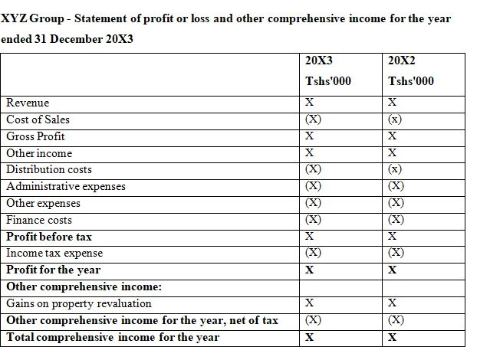
Proforma of statement of profit or loss and other comprehensive income
Notes:
The proforma given above is prepared based on the function of expense method. This is the most commonly
used method of presentation of income and expenses.

Slide 24
  Income Statement
GOOD MEN CORPORATION
Income statement
For the year ended 31st December 2017
  Revenue
    Service revenue $10,600
  Expenses
    Salaries expenses $5,200
    Supplies expenses $1,500
    Rent expenses $900
    Insurance expenses $50
    Interest expenses $50
    Depreciation expenses $40
  Total expenses $7,740
  Net Income $2,860

Slide 25
Example
From the following trial balance of B- Lane, draw up a statement of profit or loss account for the year ended 30 June 20X8
Stock at 30 June 20X8 was $16,280
Trial Balance as at 30 June 20X8
 |  | Dr | Cr
 |  | Tsh (000) | Tsh (000)
Sales |  |  | 265,900
Purchases |  | 154,870
Rent |  | 4,200
Lighting and heating expenses |  | 530
Salaries and wages |  | 51,400
Insurance |  | 2,100
Buildings |  | 85,000
Fixtures |  | 1,100
Debtors |  | 31,300
Sundry expenses |  | 412
Creditors |  |  | 15,910
Cash at Bank |  | 14,590
Drawings |  | 30,000
Vans |  | 16,400
Motor Running expenses 4,110
Capital |  |  | 114,202
Total | 396,012 |  | 396,012

Slide 26
Solution
Trading and Profit and Loss account for the year ended 30 June 20x8
 | $ | $
Sales |  | 265,900
Less: COGS
Opening stock | 0
Purchases | 154,870
Less: closing | -16,280 | -138,590
Gross profit |  | 127,310
Less: Expenses
Rent | 4,200
Lighting and heating expenses | 530
Salaries and Wages | 51,400
Insurance | 2,100
Sundry expenses | 412
Motor running expenses | 4,110 | -62,752
Profit |  | 64,558

Slide 27
Statement of financial position (SOFP)- Balance Sheet
A statement of financial position is a statement of assets, liabilities and capital of a business at a given moment. It discloses the state of affairs of the entity at that moment. Usually a statement of financial position is prepared at the end of the accounting year. The elements of a statement of financial position are:
Assets include what the entity owns or what it has to receive in the future.
Liabilities indicate the amounts due from the entity to outsiders.
Capital represents the amount that was invested by the owners into the business and the amount of Profit retained in the business (i.e. to the extent it is not withdrawn by the owners).
Any transaction or event has an effect on these three categories.
A statement of financial position is based on the accounting equation. This equation can be presented in a manner where the total of capital and liabilities is equal to the total of assets or where
Capital = Assets - Liabilities
The only difference between the statement of financial position and the accounting equation is that a statement of financial position is in a detailed format. It contains the assets and liabilities of the entity, grouped in a suitable manner

Slide 28
Purpose of statement of financial position
The worth of the business can be ascertained.
The lenders use statement of financial position to make a decision regarding provision of finance.
It helps as information to take major decisions such as expansion.
The risk bearing capacity of the entity can be known.
The comparison of statement of financial position helps to know where the business was and where it is now.
(f) Liquidity position of the entity can be calculated by analyzing the ratios.

Slide 29
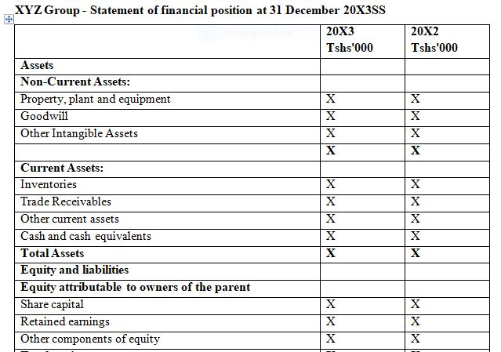
Proforma of Statement of financial position

Slide 30
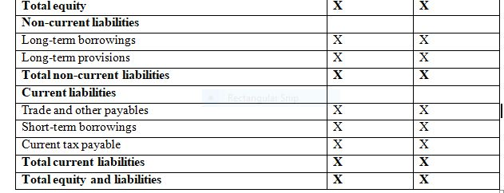
Proforma of Statement of financial position

Slide 31
Balance Sheet Defined
List of Assets Owned and Debts Owed
  At a point in time
  With dollar values attached
+ $ Assets
- $ Liabilities (Debts)
= $ Net Worth or Equity
Notes:
If the Question Is:
“Are my assets worth more than my liabilities?”
The Problem is SOLVENCY!
If Net Worth is Positive, the Business is Solvent

Slide 32
BALANCE SHEET LAYOUT
Asset
Two types of asset, fixed assets and current assets
Non current Assets/Fixed assets
Fixed assets are assets that:
Were not bought primarily to be sold; but
Are to be used in the business; and
Are expected to be of use to the business for a long time.
Examples: buildings, machinery, motor vehicles, fixtures and fittings

Slide 33
BALANCE SHEET LAYOUT
Note:-
Fixed assets are listed first in the balance sheet starting with those the business will keep the longest, down to those which will not be kept so long. For instance:
Non current assets/Fixed Assets
Land and buildings
Fixtures and fittings
Machinery
Motor vehicles

Slide 34
BALANCE SHEET LAYOUT
Current assets
Current assets are assets that are likely to change in the short term and certainly within twelve months of the balance sheet date. They include items held for resale at a profit, amounts owed by debtors, cash in the bank, and cash in hand.
These are listed in increasing order of liquidity. That is, starting with the asset furthest away from being turned into cash, finishing with cash itself. For instance:
Current Assets
Stock
Debtors
Cash at bank
Cash in hand

Slide 35
BALANCE SHEET LAYOUT
Liabilities
Two categories of liabilities, current liabilities and long-term liabilities
Current liabilities
Current liabilities are items that have to be paid within a year of the balance sheet date.
Examples: bank overdrafts, amounts due to creditors for the purchase of goods for resale.
Long-term liabilities
Long-term liabilities are items that have to be paid more than a year after the balance sheet date.
Examples: bank loans, loans from other businesses.

Slide 36
Balance Sheet
Asset Types
Current assets (<1 year)
  Consumed or converted to cash in 12 months e.g. crops, market livestock, prepaid expenses, cash, savings
Intermediate (1-10 years)
  e.g. machinery, breeding livestock, equipment, stocks, some buildings
Long Term (>10 years)
  e.g. land, buildings, stocks
  Selling would typically decrease volume or size of business

Slide 37
Balance Sheet Debt Types
Current liabilities (<1 year)
  To pay in the next 12 months e.g. bills, accrued interest, taxes, operating loans
Intermediate (1-10 years)
  What is scheduled to be paid in 1 to 10 years e.g. machinery loans, special use buildings
Long Term (>10 years)
  Scheduled originally to be paid in 11 or more years e.g. land debt, house payments

Slide 38
Balance sheet Format
GOOD MEN CORPORATION
Balance sheet as at December 31, 2005
Assets
Cash $1,400
Accounts receivable 400
Supplies 1,800
Equipment 16,000
$23,200
Liabilities and Stockholders’ Equity
Liabilities
Notes payable 5,000
Accounts payable 2,000
Total liabilities $7,000
Stockholders’ equity
Common stock 10,000
Retained earnings 6,000
Total stockholders’ equity 16,000
Total liabilities and stockholders’ equity $23,000

Slide 39
Notes to financial statements
Notes are the supplementary schedule and other information provided along with the financial statements in order to help the users of financial statements to understand the financial statements.
1, Notes form an integral part of financial statements.
2. The purpose of having notes to the financial statements is to allow the organization to disclose any relevant additional information to the reader, not covered in any of the other statements. For instance, an explanation of the type of accounting policies the organization has used is usually found in this statement.
3. Notes to financial statements may include the following information:
    significant accounting policies and explanatory notes
    risk and uncertainties affecting the organization,
    resources and obligations not recognized in the financial statements (such as mineral reserves),
    information about geographical and business segments,
    information regarding certain events which occur after the end of reporting period,
    information on the key assumptions made by the management concerning the company’s future, etc.
Notes:
Notes can be in the form of a narrative, disclosures, disaggregation of information presented elsewhere in
the financial statements or any additional information which has not been presented elsewhere in the
financial statements.
5. No format for disclosure through notes has been prescribed under IFRS. However, notes must be presented
systematically (for example, in order of items presented in the financial statements) along with proper cross
reference to items in the financial statements.

Slide 40
The following example illustrates the disclosures which are made in the notes to accounts
Property, Plant and Equipment- The Management estimates the useful lives for the assets as follows: Buildings 20 years, Plant and machinery 10 years, Furniture and fixtures 13 years ,Vehicles 5 years
Provisions and contingencies- A provision is recognized in the Statement of Financial Position when the Company has a present legal or constructive obligation as a result of a past event, it is probable that an outflow of economic benefits will be required to settle the obligation and a reliable estimate can be made of the amount of the obligation
Inventory- valued at the lower of acquisition or production cost and net realizable value. The cost is generally determined on the basis of a first-in, first-out method. Production costs comprise direct material and labour and applicable manufacturing overheads, including depreciation charges. Net realizable value is the estimated selling price in the ordinary course of business, less the estimated costs of completion and selling expenses At the reporting date, inventories costing Tshs1 million had a net realizable value of Tshs0.8 million. These inventories are written down to the net realizable value and the difference of Tshs0.2 million is charged to the cost of sales for the year 2011.

Slide 41
Purpose of Disclosure Notes
Provide clarification- The information contained within the disclosure notes not only supplements financial statement information, but also clarifies line-items that are a part of the financial statements. Disclosure notes provide information about how the amounts reported in the financial statements were determined
Accounting policy followed- Disclosure notes are also used to explain the accounting policies used and valuation model used to prepare the financial statements. Non-current assets - whether the cost model or the revaluation model and Method of valuing inventory - whether FIFO or Weighted Average Cost
Identification-
Comparative information
Timeliness

Slide 42
information is to be displayed prominently and repeated when necessary
Name of the reporting entity or any other means of identification (e.g. logo), and any changes therein from the end of the preceding period
Whether the statements cover an individual entity or a group of entities
The end date of the reporting period or period covered by financial statements
Presentation currency (e.g. Tshs, Euro, US$)
Level of rounding off used in presenting amounts (e.g. to the nearest thousand)

Slide 43
Relationship between the main financial statement components
The relationship between the statement of financial position and the statement of profit or loss and other comprehensive income is very significant.
Profit for the year as shown by the statement of profit or loss and other comprehensive income is added to the capital of the owner in the case of a sole trading firm or a partnership firm. In the case of a company, the amount of profit is added (loss deducted from) to the statement of financial position as ‘Retained Earnings’. the components of other comprehensive income are taken to the suitable account under the ‘Equity’ group. The equity group of accounts consists of the accounts representing capital and other reserves belonging to the owners (shareholders).

Slide 44
Relationship between the main financial statement components
The loss made during a period determined by the statement of profit or loss is deducted from the owners’ capital. When the owners’ capital decreases, the net assets of the business are decreased by an amount equal to the loss. This is how the accounting equation is maintained.
Business expenses are disclosed in the statement of profit or loss whereas personal expenses paid are treated as drawings, and reduced from the capital in the statement of financial position
Accrued expenses that are not paid at the end of the reporting date are added to the relevant expenses in the statement of profit or loss and recorded as a liability in the statement of financial position
Accrued income that is not received by the reporting date is added to the relevant income in the statement of profit or loss, and as an asset in the statement of financial position

Slide 45
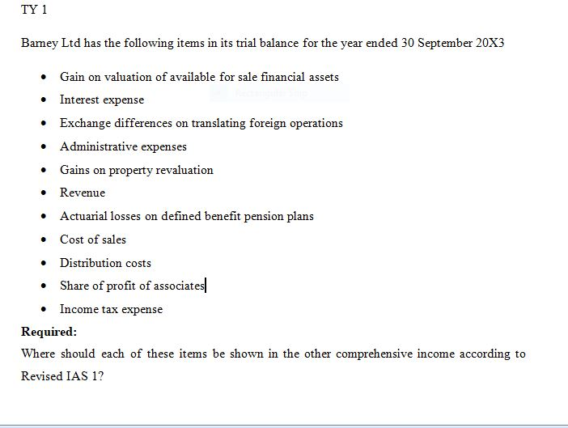
TY 1

Slide 46
Elements of financial statements
Financial statements are the end result of the financial accounting process. Financial accounting process consists of recording the transactions through journal entries, posting the entries in appropriate ledger accounts, casting of accounts and preparing the trial balance.
An organisation’s financial statements consist of four summary reports accompanied by notes to these statements as set out in IAS 1 Presentation of financial statements. Each statement provides separate but complementary information about the financial condition and performance of the organisation. Hence, to get a complete financial picture of the organisation, all five statements need to be prepared. The following diagram briefly describes these statements

Slide 47
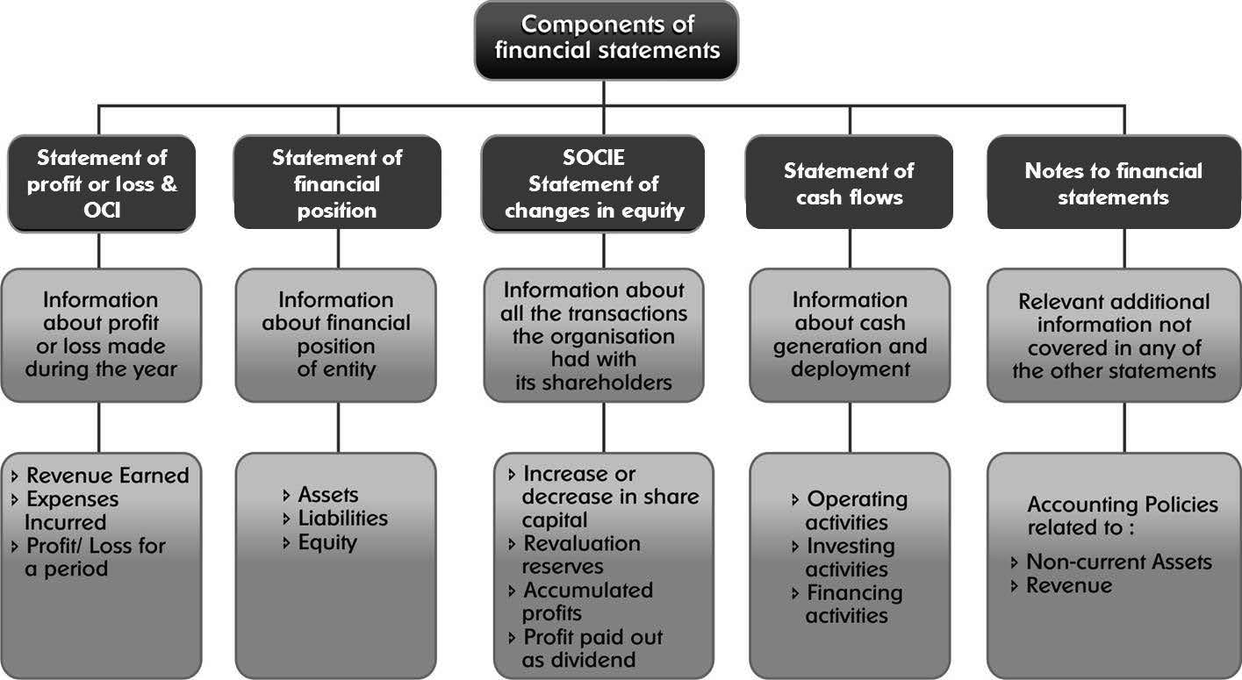
Purpose and elements of financial statements

Slide 48
Conclusion
Cooking food well is only half the job: The food will not be relished unless it is served in a proper manner! Similarly, doing day-to-day accounting well is only half the job. It will not serve its purpose unless the results are presented in a proper format, with the required content.
Financial statements are important as they enable shareholders, banks, trade payables, etc. who are the external users of financial statements to assess the financial status of the company.
Financial statements only deal with past events and generally do not contain non-financial data

