Slide 1
Cash Book
Ibrahim Y

Slide 2
Introduction
Cash is the most liquid resource that an entity has. Cash includes cash and cash equivalents both in hand as well in the bank. There are several transactions every day that cause a continuous flow of cash between the entity and outsiders, and also within the entity itself. Cash, being so liquid, is also the biggest moral hazard! It is easier to commit a fraud or an error in cash transactions, as compared to any other kind of transactions. Cash is a lifeline for a business. It affects almost all the departments and business segments. Proper records of cash transactions are important not only for accounting purposes, but also to help the financial manager in efficiently managing the cash.

Slide 3
Cash Book
The cash book is a book of prime entry of a special kind as it is also a part of the ledger system. Cash or bank columns serve the purpose of cash or bank accounts, often in a ledger account. There is no need to post the transactions again in cash or bank accounts. These columns are balanced just like a ledger account and the closing balances are taken into a trial balance.
A cash book is a complete record of all cash and bank transactions.
The cash book consists of the cash account and the bank account put together in one book.

Slide 4
The main features of the cash book are as follows
Only cash transactions are recorded in the cash book.
Transactions are recorded in the cash book in a chronological order.
The receipts side of the cash book is used to record entries which debit cash or bank account for example: received cash from one of the customers.
The payments side is used to record entries which credit cash. For example: paid salary by cash.

Slide 5
Types of cash book
Single column for cash as well as bank transactions - If there is only one column for cash and bank transactions, the balance brought down and carried forward will consist of cash-in-hand as well as bank balances (especially, if there is any cash that is not yet deposited into the bank). If all the cash collections are deposited in the bank, the balance will consist of only the bank balance.
The two column cash book: different columns for cash and bank transactions (a) Cash and bank transactions are recorded in the respective cash and bank columns. The steps to record transactions in the cash book have been explained earlier. (b) Transactions between cash and bank are recorded as contra transactions in the cash book with cash and bank columns.

Slide 6
Three column or Analytical columns
Certain additional analytical columns are drawn on either side of a cash book according to the accounting and reporting needs of each entity. These columns are totalled and not balanced. The totals are used for the purpose of summary postings into ledger accounts e.g. discount allowed, accounts receivable, cash sales, sales tax on cash sales etc.
If analytical columns are maintained, instead of individual entries, only the totals are recorded to the respective ledger accounts. For example, if columns are maintained for accounts receivable and cash sales, the totals of these columns will be recorded in the accounts receivable and cash sales ledger account. Individual transactions of accounts receivable are posted in the personal ledgers, which are not part of the double entry system.

Slide 7
Cash Discounts
Businesses prefer it if their customers pay their accounts quickly. A business may accept a smaller sum in full settlement if payment is made within a certain period of time. The amount of the reduction of the sum to be paid is known as a 'cash discount. The term 'cash discount' thus refers to the allowance given for quick payment. It is still called cash discount, even if the account is paid by cheque or by direct transfer into the bank account.

Slide 8
Discounts allowed and discounts received
A business may have two types of cash discounts in its books. These are:
Discount allowed, cash discounts allowed by a business to its customers when they pay their accounts quickly, being an expense is always debited.
Discount received, cash discounts received by a business from its suppliers when it pays what it owes them quickly, being an income is always credited

Slide 9
Discounts columns in cash book
The discounts allowed account and the discounts received account are in the general ledger along with all the other revenue and expense accounts. It has already been stated that every effort should be made to avoid too many entries in the general ledger. To avoid this, we add two columns for discount in the cash book.
An extra column is added on each side of the cash book in which the amounts of discounts are entered. Discounts received are entered in the discounts column on the credit side of the cash book, and discounts allowed in the discounts column on the debit side of the cash book.

Slide 10
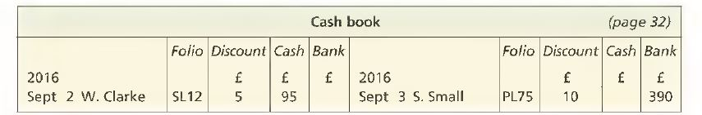

Slide 11
Receipts
As stated above, cash or bank columns on the receipts side of the cash book perform the function of the debit side of a cash or bank account. Therefore, only the credit side of the journal entry needs to be recorded in the ledger. The general rule is that for each receipt in the cashbook, only the credit side has to be recorded in the respective account.
Payments
Cash or bank columns on the payments side of the cash book perform the function of the credit side of a cash or bank account. Therefore, only the debit side of the journal entry needs to be recorded in the ledger. The general rule is that for each payment in the cash book, only the debit side has to be recorded in the respective account

Slide 12
Bank Overdraft
A business may borrow money from a bank by means of a bank overdraft. This means that the business is allowed to pay more out of its bank account than the total amount it has deposited in the account. Up to this point, the bank balances have all been money at the bank, so they have all been assets, i.e. debit balances. When the bank account is overdrawn, the business owes money to the bank, so the account is a liability and the balance becomes a credit one.

Slide 13
Contra Entry
Contra entry refers to transactions involving cash and bank account. In other words, any entry which affects both cash and bank accounts is called a contra entry
A contra entry is also used in the Intercompany netting to offset receivables and payables between 2 different legal entities/subsidiaries of a company so that one final (net) amount remains.

Slide 14
Entries in the Folio Column.
The “folio” column is used to write the name of the other book and its page number in abbreviated form.
The abbreviations are for example:
CB Cash Book
SL Sales Ledger
GL General Ledger
If double-entry is completed on the same page, such as in the Cash Book for the Cash and Bank columns, the letter “C” is used, to mean “Contra”.

Slide 15
Example of a cash book with folio columns
The following transactions are written up in the form of a Cash Book. The folio columns are filled in as though all the double entries had been completed to other accounts.

Slide 16
Example : To enter transactions in the Cash Book
2000 July | 1 | Balance brought forward of Tshs. 250 cash and Tshs 10,000 at bank.
 | 2 | Received check from Bakari worth Tshs. 1,500
 | 3 | Cash sales of Tshs. 900
 | 5 | Paid rent of Tshs. 250 cash
 | 8 | Deposited Tshs. 650 cash into bank
 | 12 | Sold commodities by cheque for TSh 450
 | 20 | Paid Magori by cheque of Tshs 2,800
 | 28 | Drew cash from bank amounting to Tshs. 1,500
 | 31 | Paid wages of Tshs. 1,500 cash

Slide 17
Solution to Example :
Cash Book
Dr Cr
Year
Date
Partic
F
Cash
Bank
Year
Date
Partic
F
Cash
Bank
Month
Sh.
Sh.
Month
Sh.
Sh.
2000
2000
July
1
Balance
b/f
250
10,000
July
5
Rent
GL2
250
2
Bakari
SL5
1,500
8
Bank
C
650
3
Sales
GL3
900
20
Magori
PL6
2,800
8
Cash
C
650
28
Cash
C
1,500
12
Sales
GL3
450
28
Bank
C
1,500
31
Wages
GL8
1,500
31
Balances
c/f
250
8,300
2,650
12,600
2,650
12,600
August
1
Balances
b/f
250
8,300

Slide 18
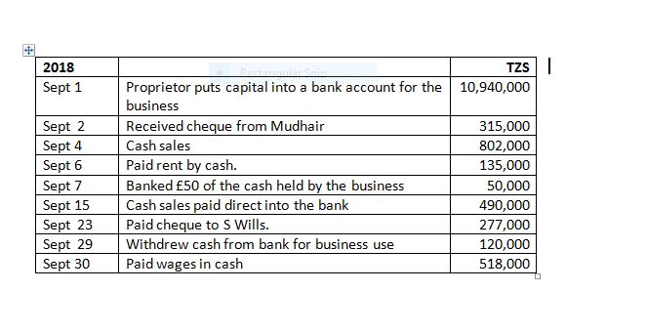
Example: Cash Book

Slide 19
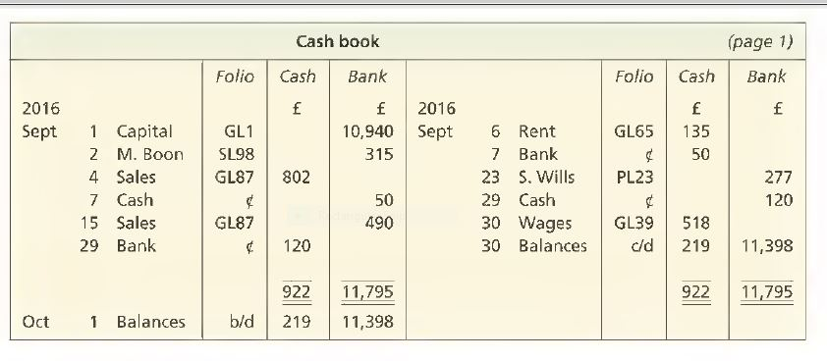
Solution

Slide 20
THE END
THANK YOU
FOR LISTENING

